Slide 1
Phonepe Pulse Data Visualization and Exploration:
A User-Friendly Tool Using Streamlit and Plotly
Devadath G Nair

Slide 2
Introduction
This Streamlit dashboard processes Phonepe pulse Github repository data for comprehensive user-friendliness. It includes extensive metrics, resulting in a live geo visualization dashboard. The MySQL database efficiently stores data for dynamic updates, ensuring the latest information is presented interactively with various widgets.
GitHub Link : https://github.com/DevadathGNair/Phonepe_Pulse_Data_Visualization_and_Exploration

Slide 3
Steps
The following are the steps done in the project:
Data Extraction
Data Preprocessing and Transformation
Data Storing in MySQL
Live Geo Visualization Dashboard Creation

Slide 4
Data Extraction
The Phonepe pulse Github repository contains a large amount of data related to various metrics and statistics. All these data are stored in 3 different folders in the github repository.
Aggregated - Aggregated values of various payment categories as shown under Categories section
Map - Total values at the State and District levels.
Top - Totals of top States / Districts /Pin Codes
All the data provided in these folders is of JSON format.

Slide 5
The first step is to extract the data from the github repository. Initially, the github repository is cloned. The data is then extracted from aggregated, map and top folders by specifying the path.
Each folders include transaction and user folders within it.
These data are extracted and dataframes were created for each of them. So, a total of 8 different dataframes were created for each transaction and user.
While handling the data from top folder, a total of 4 dataframes were created based on districts and pin, since there were a difference in the length of data.

Slide 6
Data Preprocessing & Transformation
The next step was to clean the data in the 8 different dataframes created.
During the initial analysis, null values were found in the data extracted from the top folder.
These null values were handled by imputing them with the mode values for their respective columns.

Slide 7
Data Storing in MySQL
Once the data was preprocessed, the next step was to connect to the MySQL and create a database and 8 different tables within it for each respective dataframes.
The data was then inserted to their respective tables after transforming the data to the required format.
Once the data was inserted to the database, the next step was to generate insights and create visually appealing and user interactive dashboard.

Slide 8
Live Geo Visualisation Dashboard
In the dashboard, there are 6 sections in total.
In the first section, it shows 3 different widgets for showing:
Most Users
Most Transaction
Highest Transaction Amounts
Most Users shows the state with the most user count along with the count of it.
Most Transactions shows the state where the most transactions has occurred along with the count of it

Slide 9
Highest Transaction Amount shows the state which has the highest total transaction amount along with the total amount.
The second section shows the live geo visualisation of india map.
There are 4 different dropdowns within it:
Transactions or Users
State
Year
Quarter
If the user selects Transaction, the user would be able to see the transaction of each states in India along with the amount in the heatmap.
The user can also select different states individually along with the year and quarter, which then generates the map of that particular state along with the amount and changes dynamically when the options are changed.

Slide 10
If the user selects “Users”, they would be able to see the user count of each states in India along with the number in the heatmap.
The user can also select different states individually along with the year and quarter, which then generates the map of that particular state along with the number and changes dynamically when the options are changed.
The next section shows a bar chart which shows the transaction count of all states based on the transaction types.
Here also, the user can change the state, year and quarter and it generates the output dynamically.
The next section shows a donut chart which shows the transaction amount based on the type of transaction.
Here also, the user can change the state, year and quarter and it generates the output dynamically.

Slide 11
The next section shows a multi-line chart which depicts the total transaction amount for each quarter.
Here, each line depicts different years and the variation shows the change in transaction amount for each quarter.
The next and the final section shows a multi-line chart which depicts the total registered users in each quarter.
Here, each line depicts different years and the variation shows the change in registered users for each quarter.

Slide 12
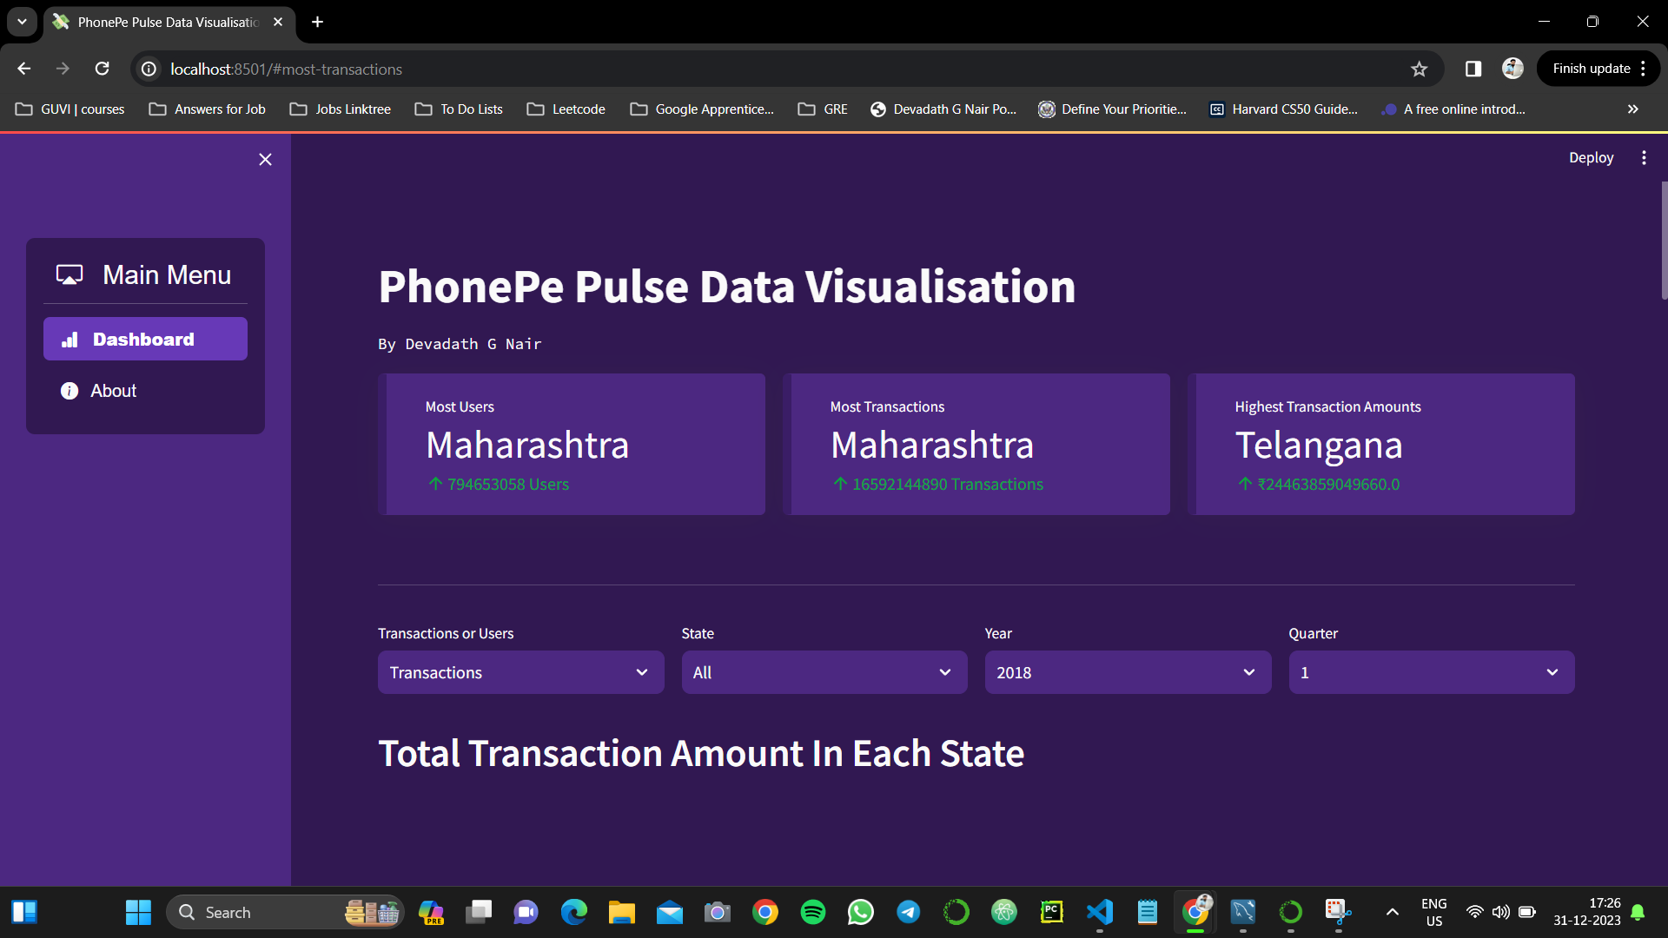
Results

Slide 13
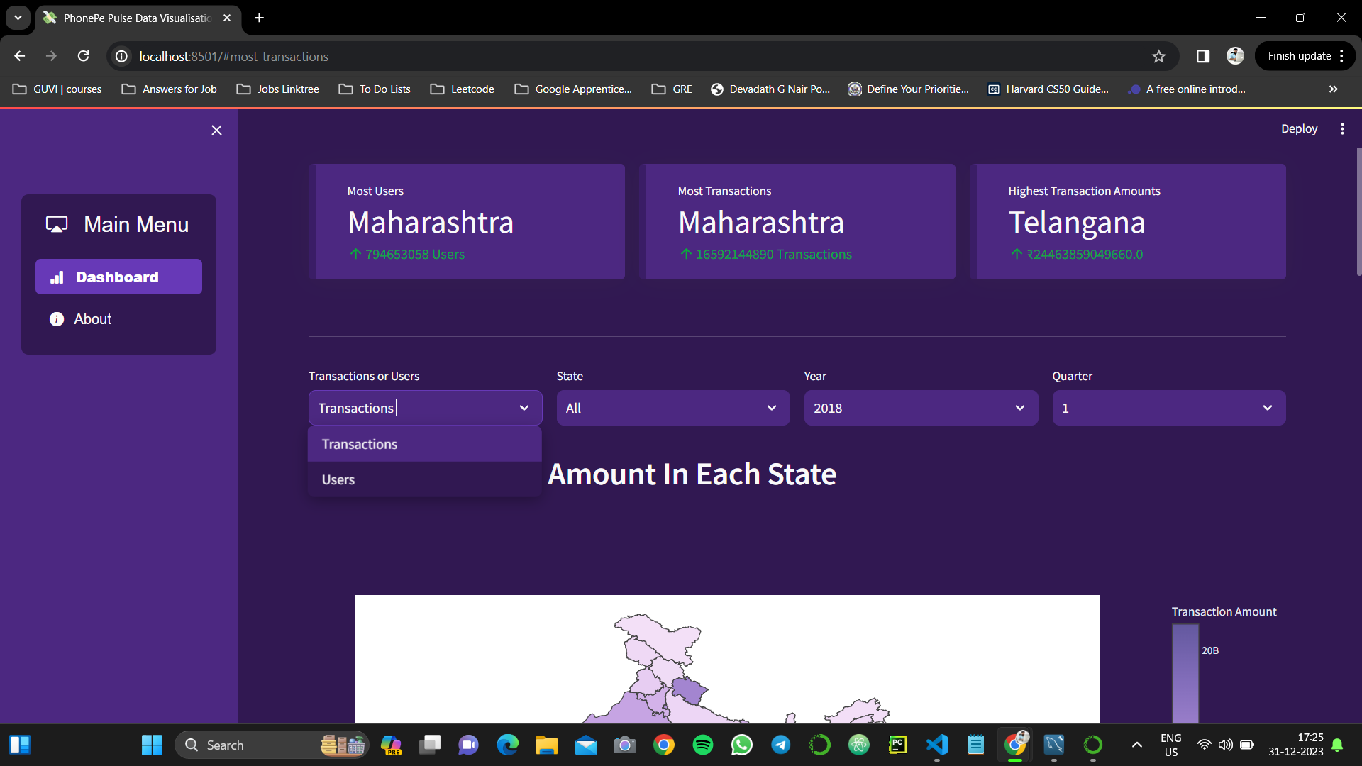
Results Cont.

Slide 14
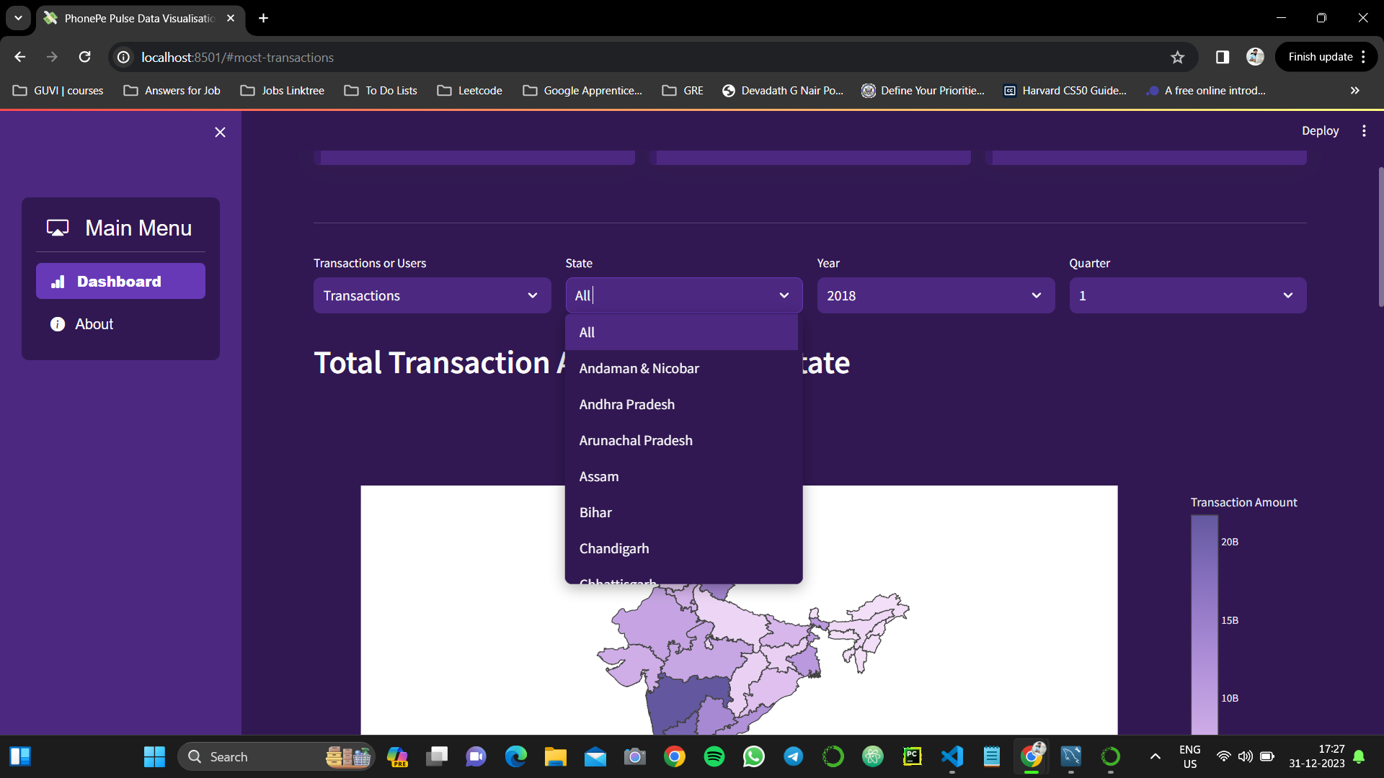
Results Cont.

Slide 15
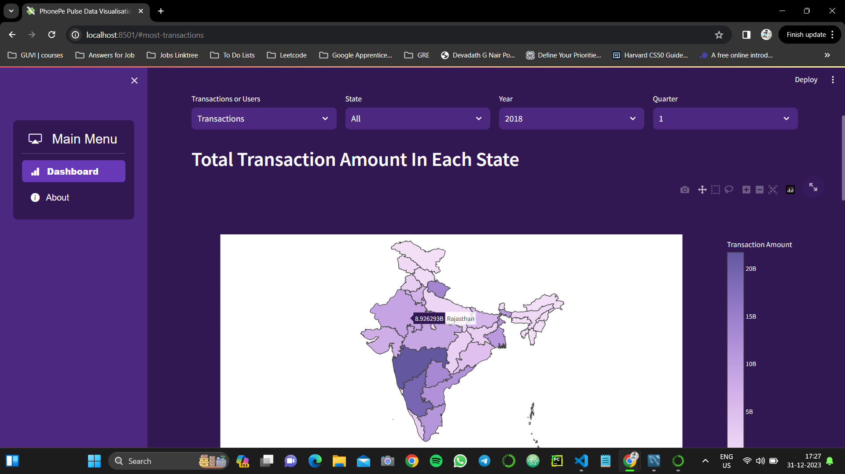
Results Cont.

Slide 16
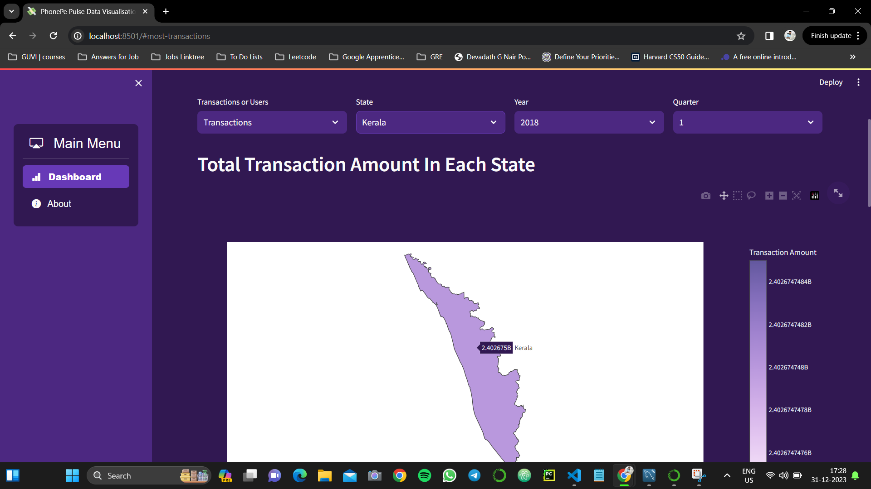
Results Cont.

Slide 17
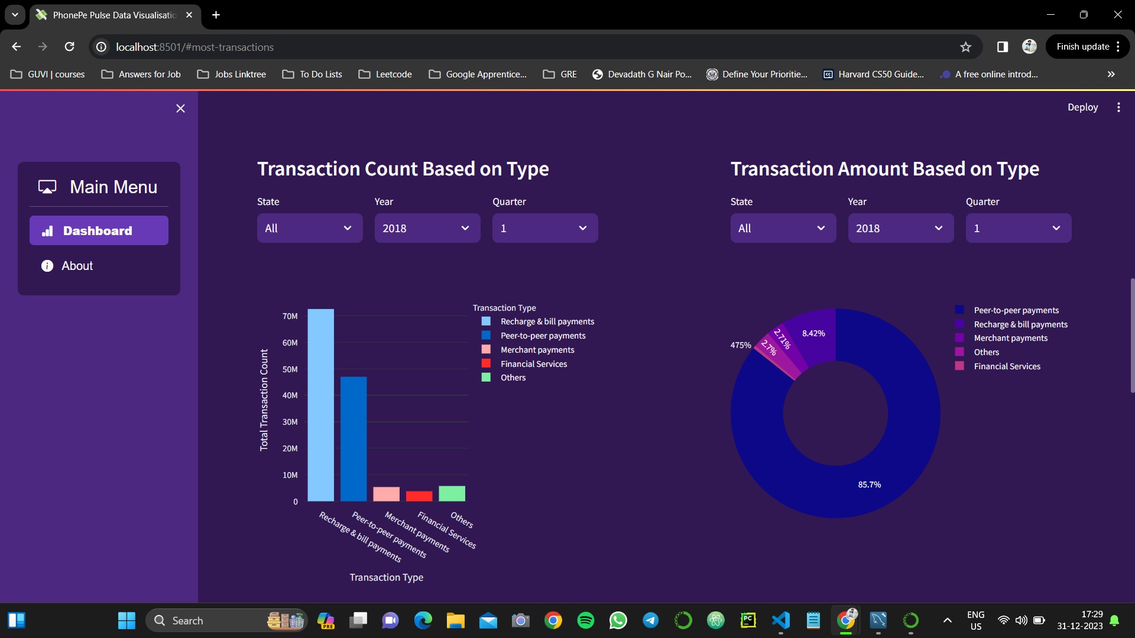
Results Cont.

Slide 18
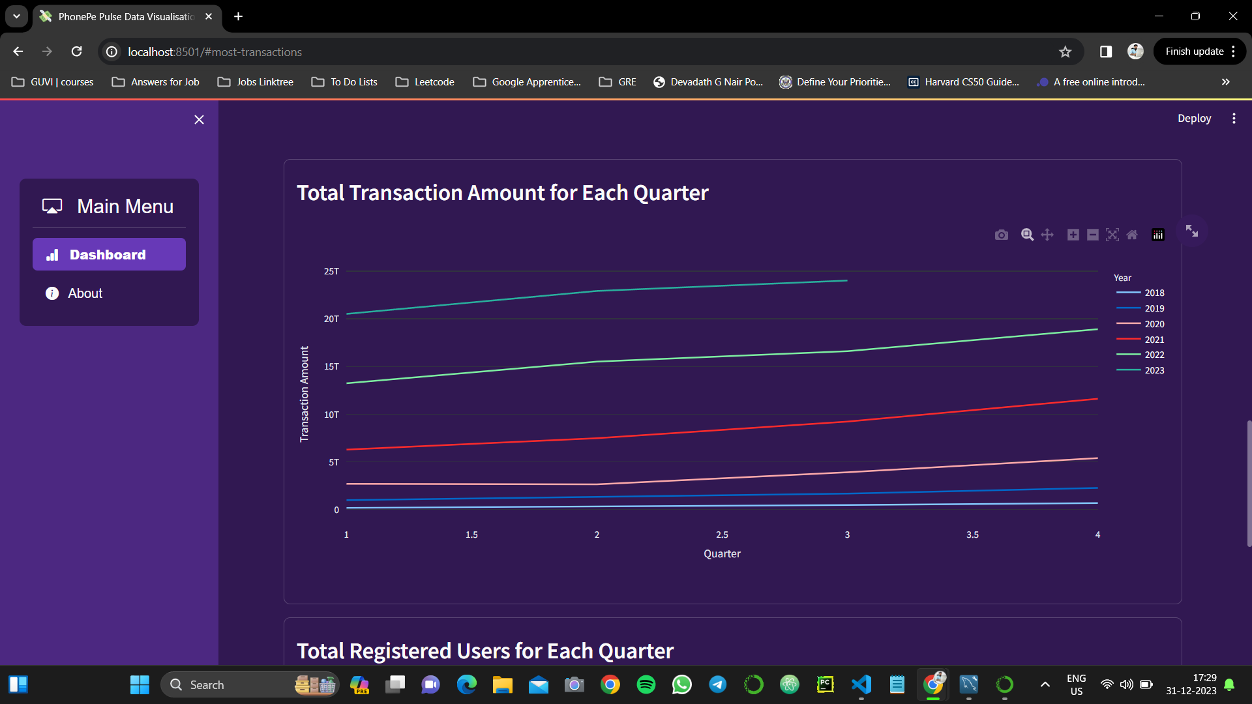
Results Cont.

Slide 19
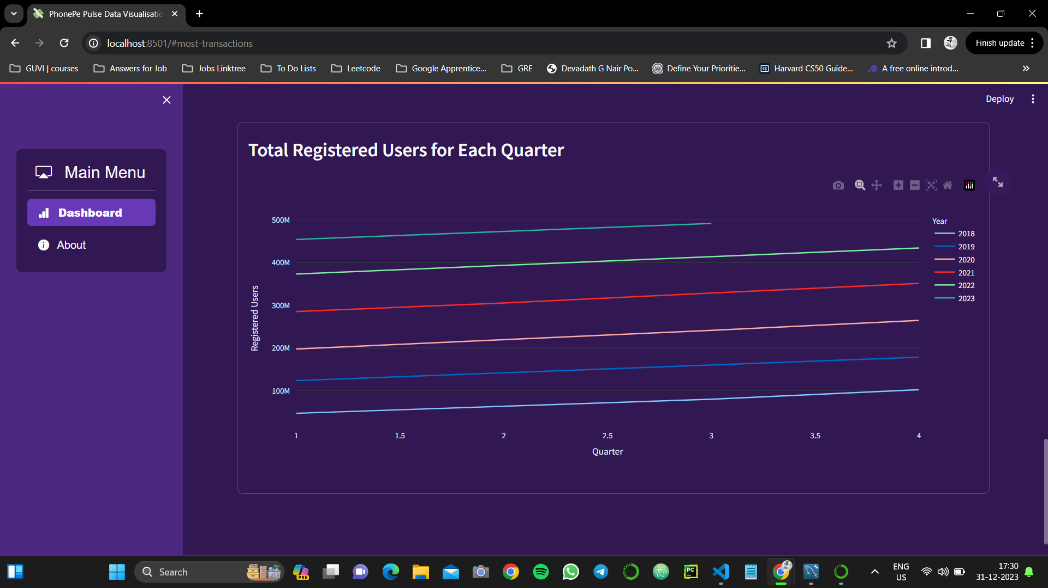
Results Cont.

Slide 20
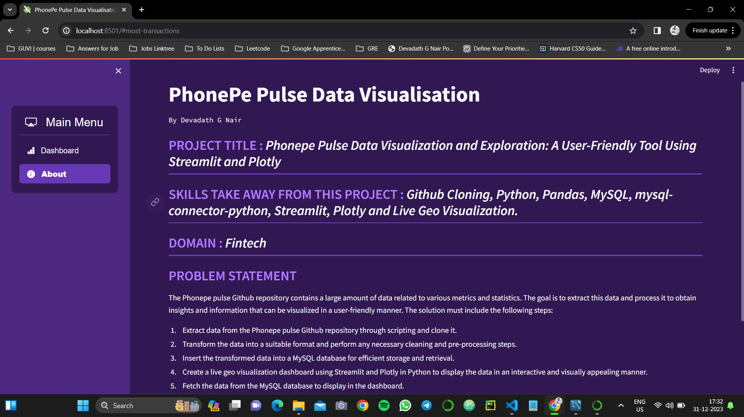
Results Cont.

Slide 21
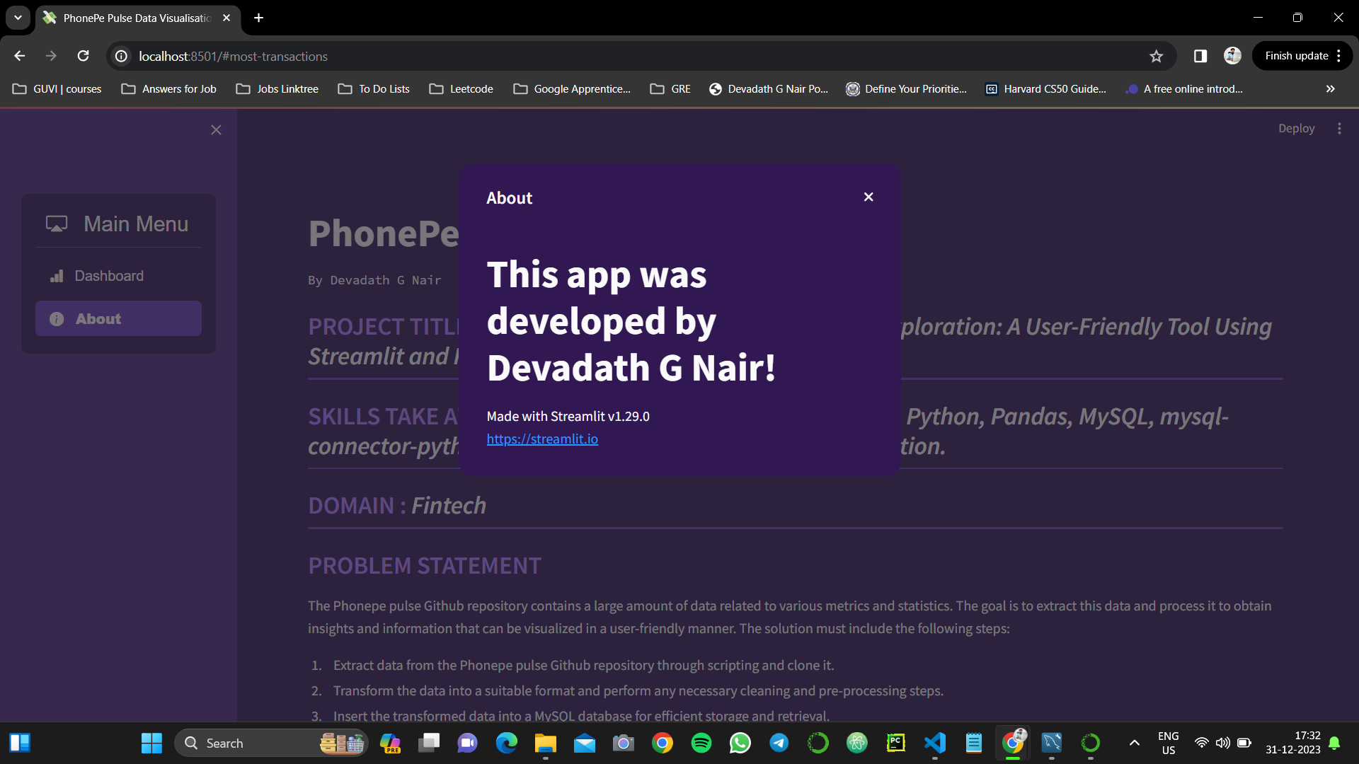
Results Cont.

